Slide 1


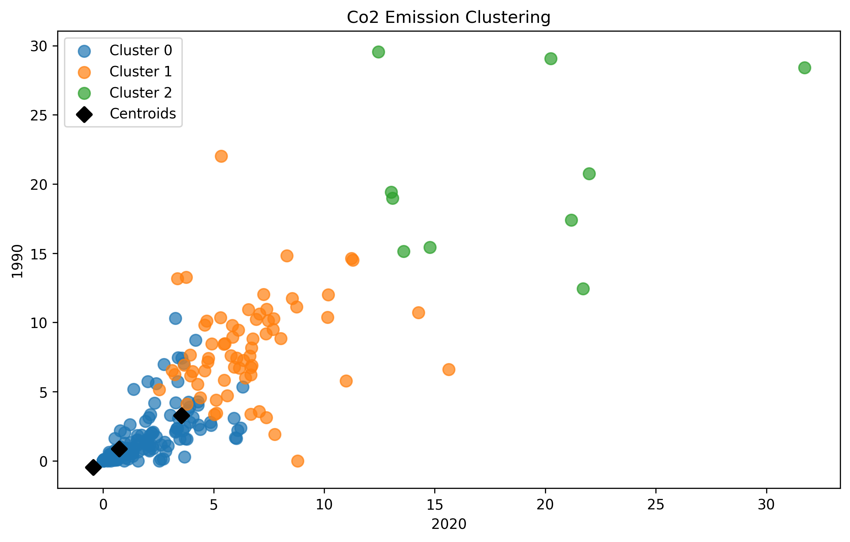
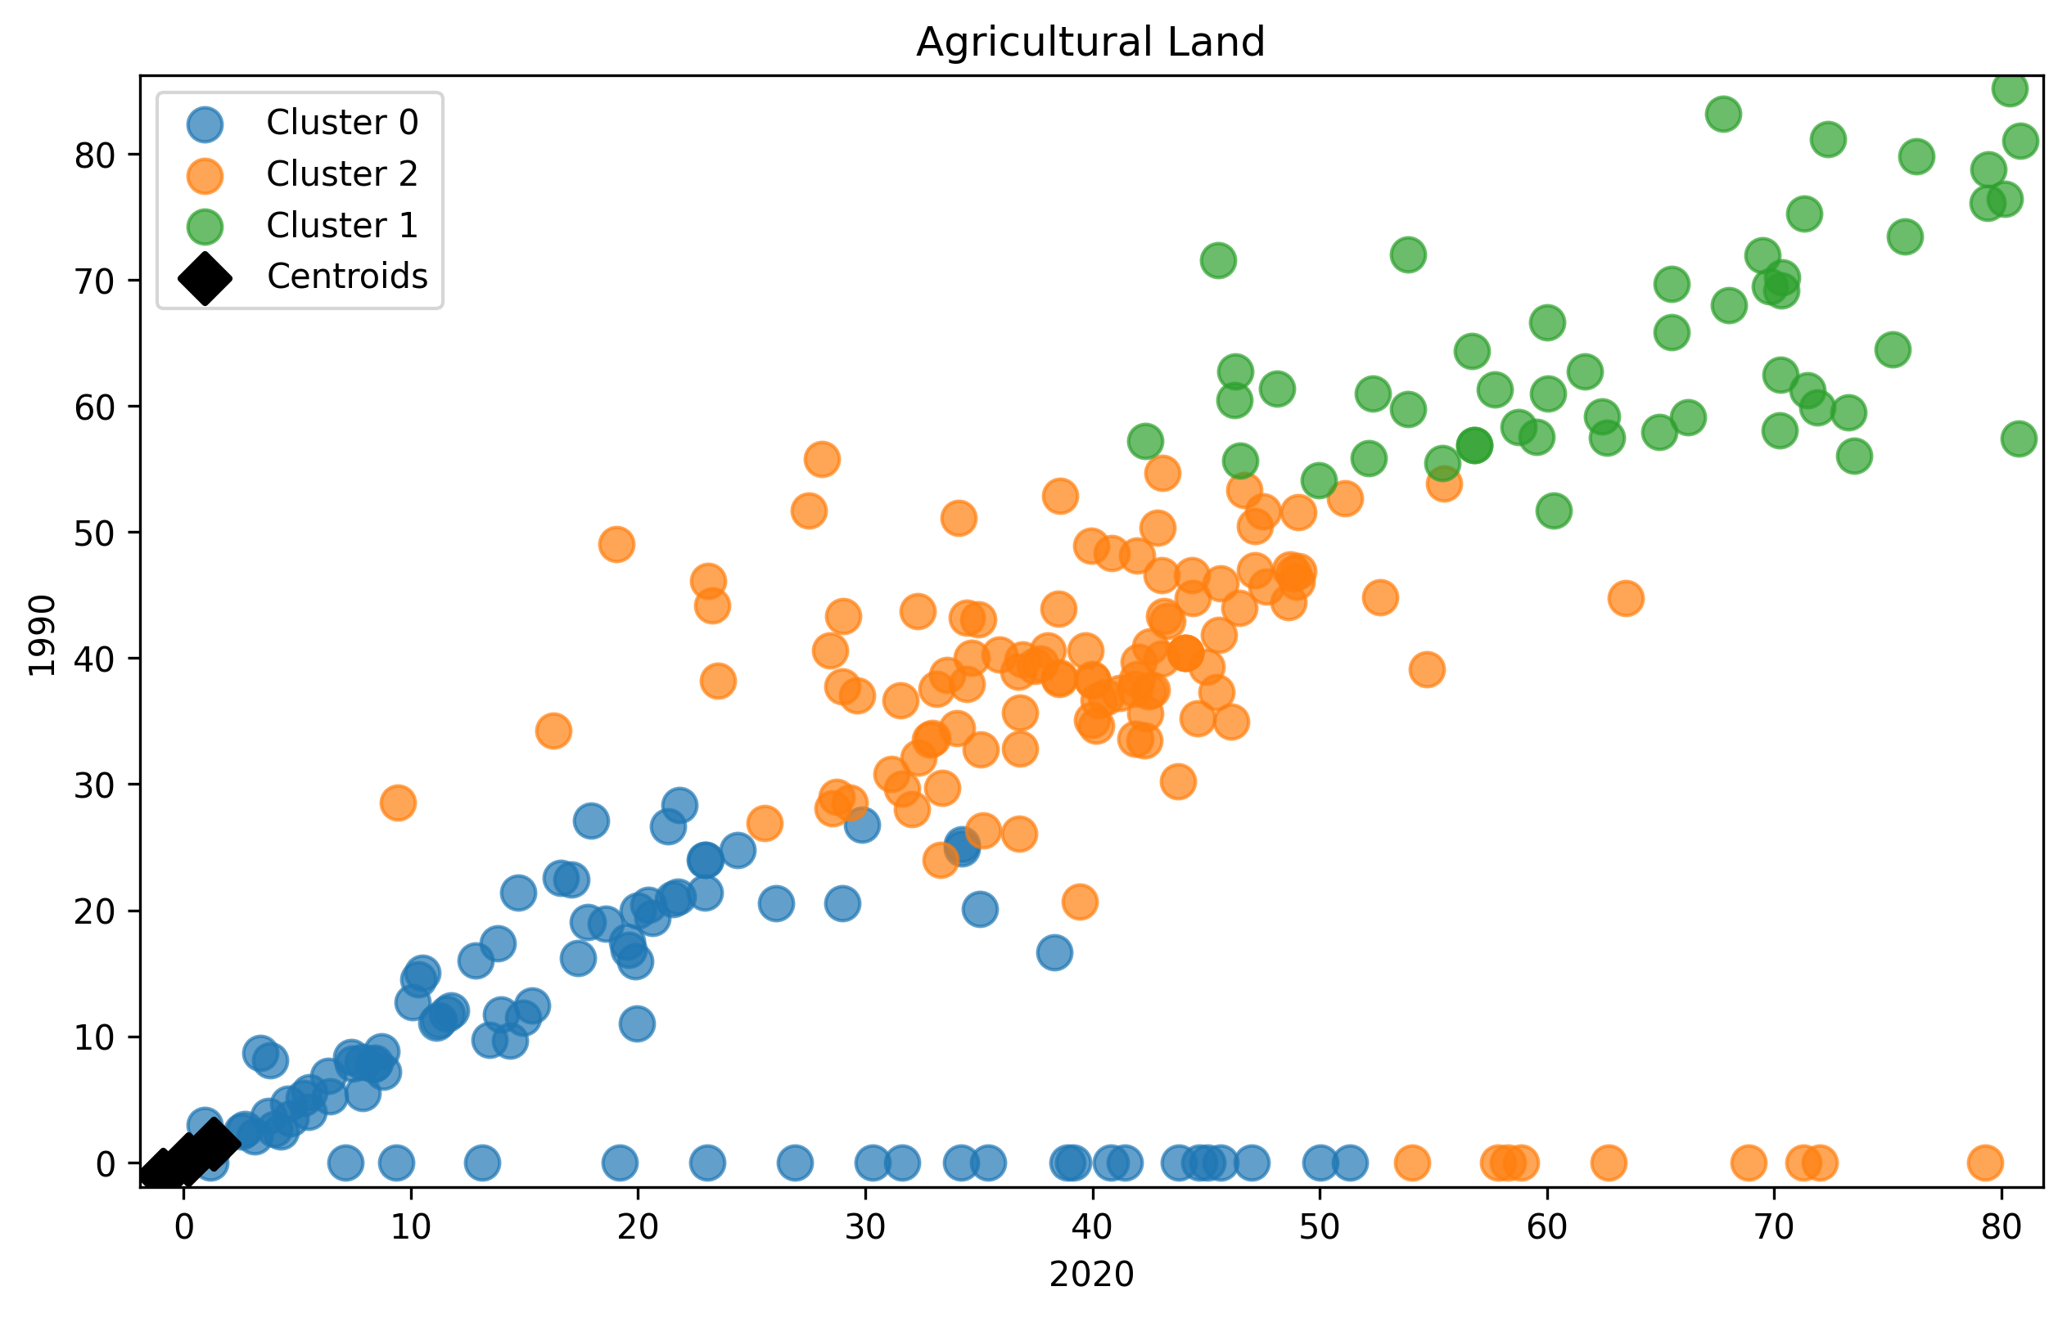
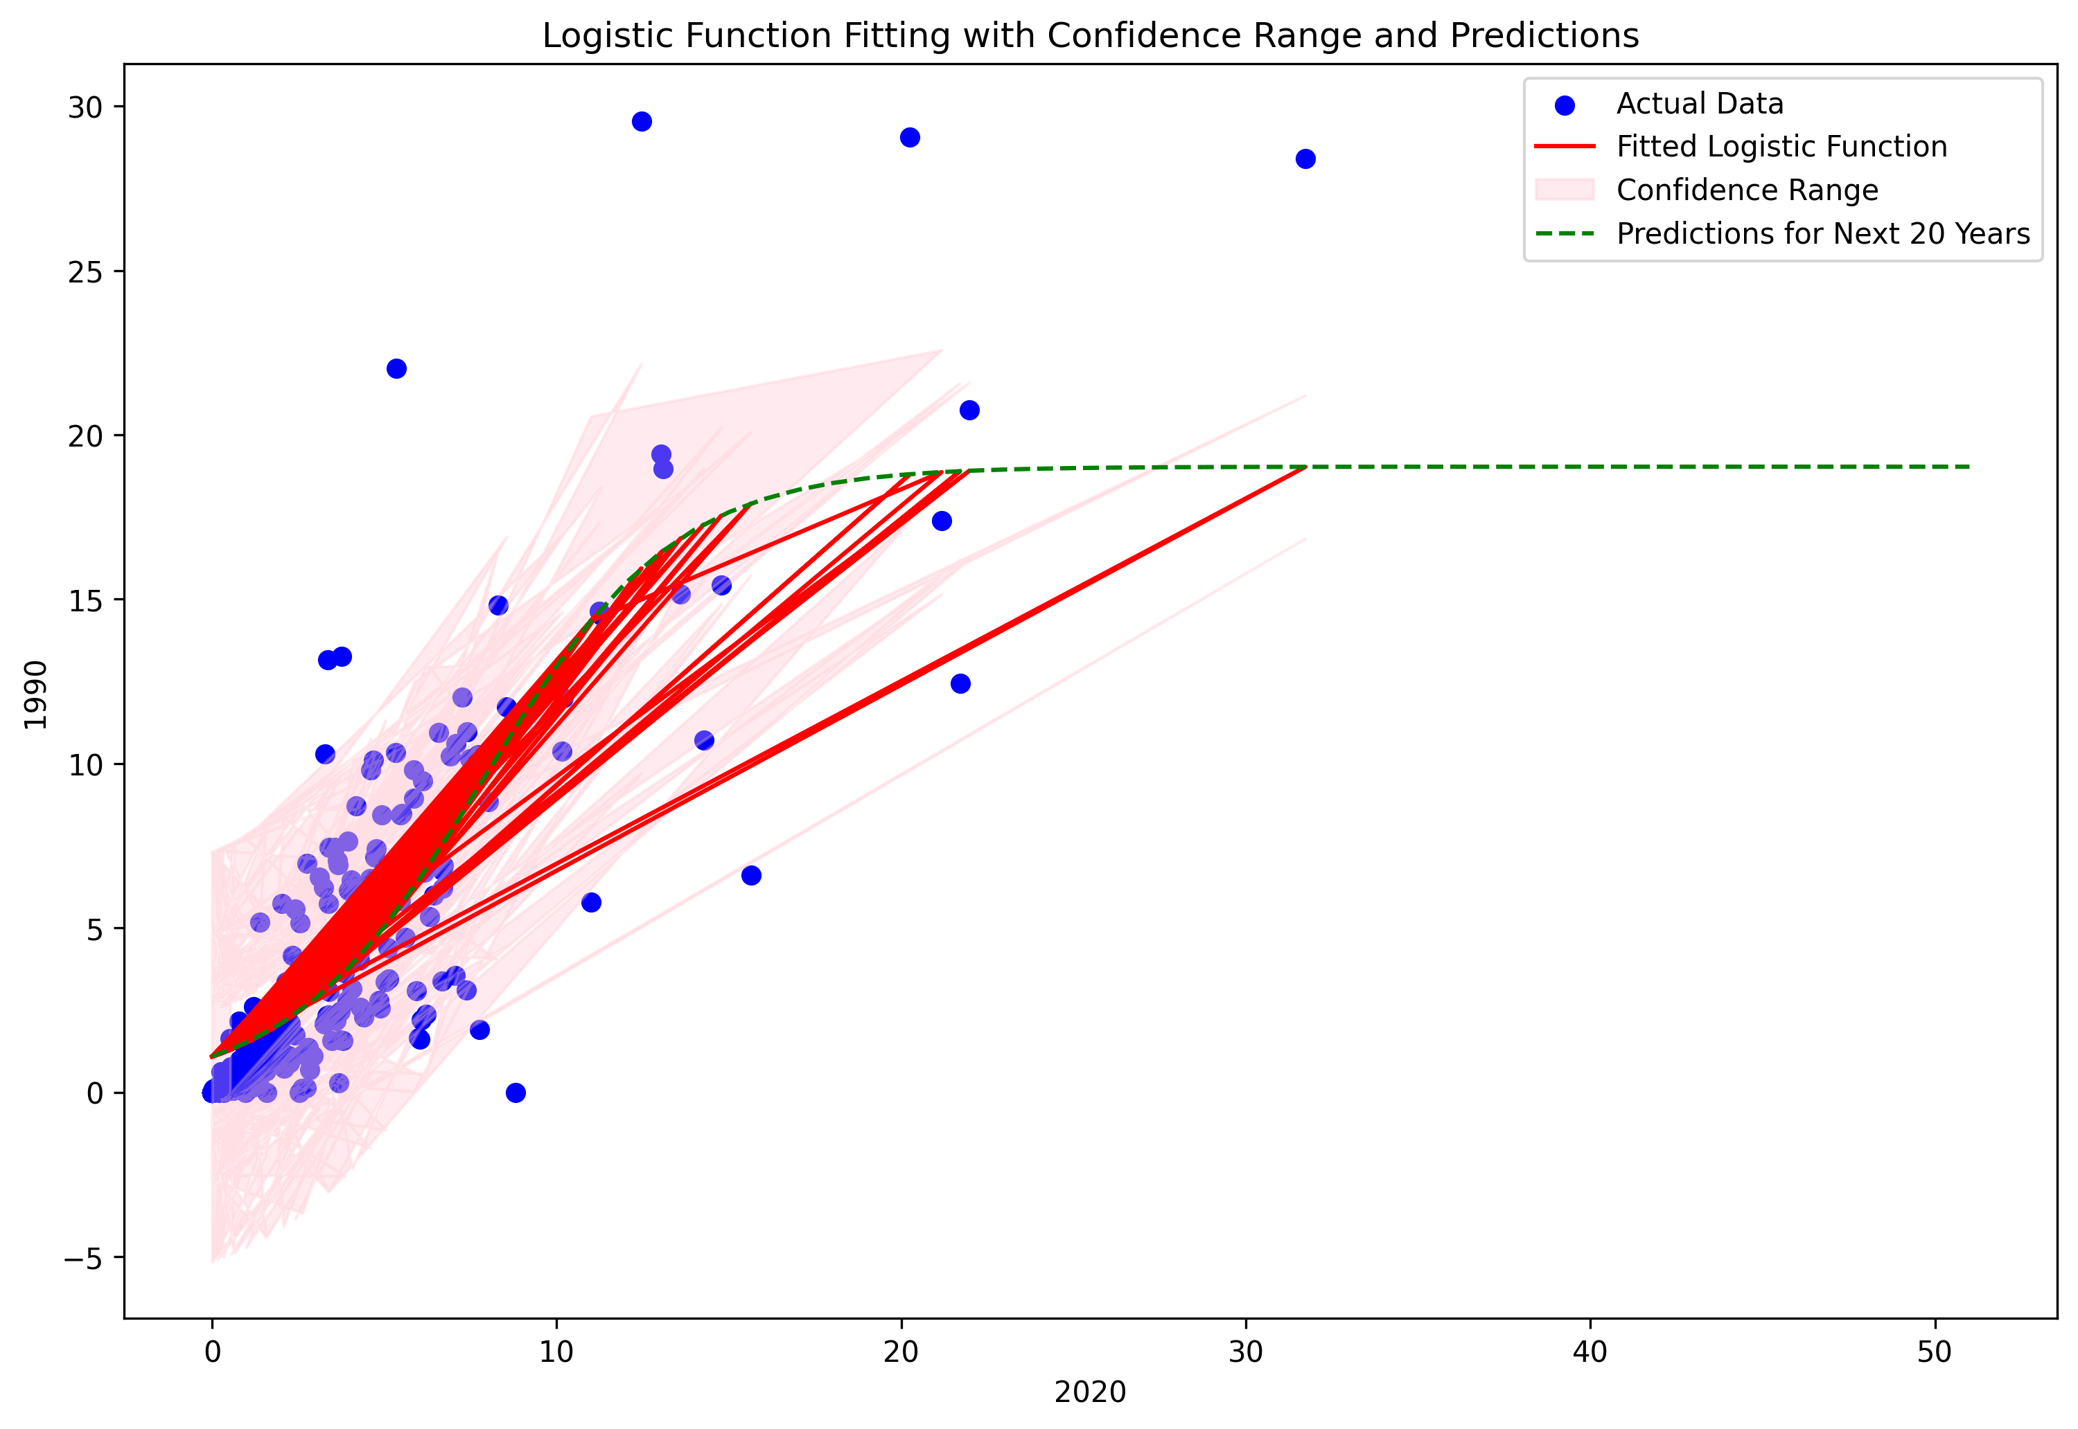

Analysing CO2 Emission, Agricultural Area and its Relation With Future Analysis and Prediction
By Abigith Benson Benzigar
Abstract
The aim of the study is to collect data from world bank and analyse the data and find the relation between CO2 and climate change, in this study clustering and fitting techniques were used.
The data was processed, transposed, cleaned. K-means clustering and fitting methods were used in this study
The relation between CO2 and forest area is found and through clustering method and the future of CO2 emission for 20 years is predicted.
Introduction
The rise in CO2 emission and deforestation is one of the leading causes of climate change we studied the CO2 emission data from the year 2020 and the year 1990 across 10 years.
The data occurred is referred with the agricultural land data for further improving our understanding of its effects. With all the possible data we collected we predict the future of CO2 emission to get a clear image ahead of us
The fig 1 shows the CO2 emission data of 2020 compared to 1990, and the cluster suggest that the CO2 emission is increasing and have a positive correlation, which suggest that the CO2 data is increasing by the year.
The fig 2 shows the Agricultural land data of 2020 compared to the data of 1990 from 10 years, there is a massive spike in agricultural land and it has a positive correlation, which suggest that the Agricultural land is increasing.
From the Fig 1 & Fig 2 we can state that while the CO2 is increasing the amount of Agricultural land is also increasing every year to cope up with the increasing population.
This means that the increasing Agricultural land contribute to de-forestation and
Conclusion
The world bank data collected and the k-means clustering of the collected data shows that the CO2 have been increasing from 1990 because of all the emission and the deforestation.
From the data fitting estimated that even though the CO2 emission is increasing the future of CO2 emission is stable and will continue to be Stable for the next 20 years.
Links
Git hub: https://github.com/Abiben100/ADS1-Assignment-3.git
Data: CO2 data , Agricultural land data https://data.worldbank.org/indicator/EN.ATM.CO2E.PC?view=chart
https://data.worldbank.org/indicator/AG.LND.AGRI.ZS?view=chart
Fig 3 shows the fitting function which shows the prediction for the next 20 years, which is pretty much surprising as the CO2 is increasing slowly but surely and the other factors like Agricultural land expansion, de-forestation seems to be increasing. The population also seem to be increasing, but one of the reason for the stable CO2 emission for next 20 years can be because of all the climate change campaign and the switching of Fuel cars, UK is supposed to be all electric by 2030

